Slide 1
DevOps
Notes:
https://courses.cs.washington.edu/courses/cse403/13au/lectures/git.ppt.pdf
http://enos.itcollege.ee/~jpoial/allalaadimised/git/getting-started-with-git.pdf

Slide 2
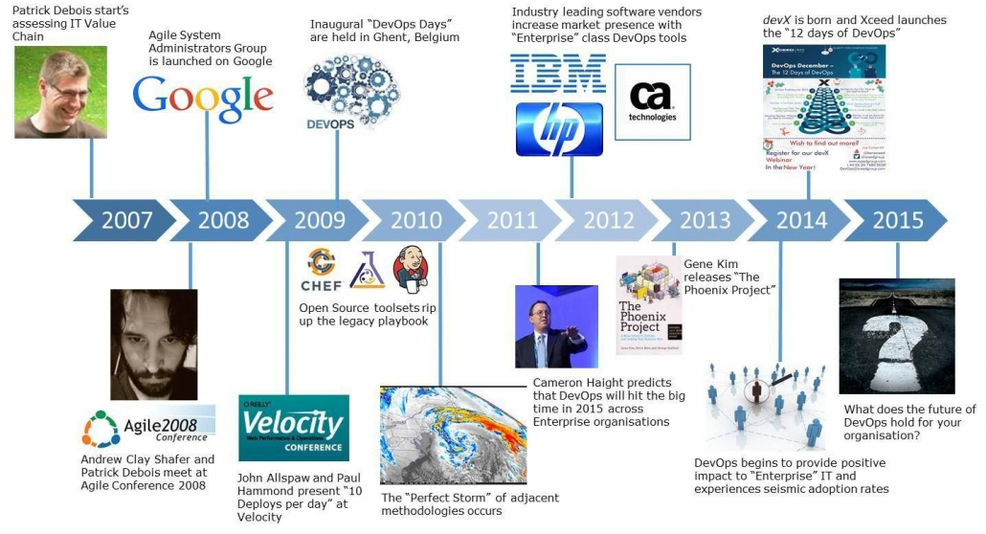
History

Slide 3
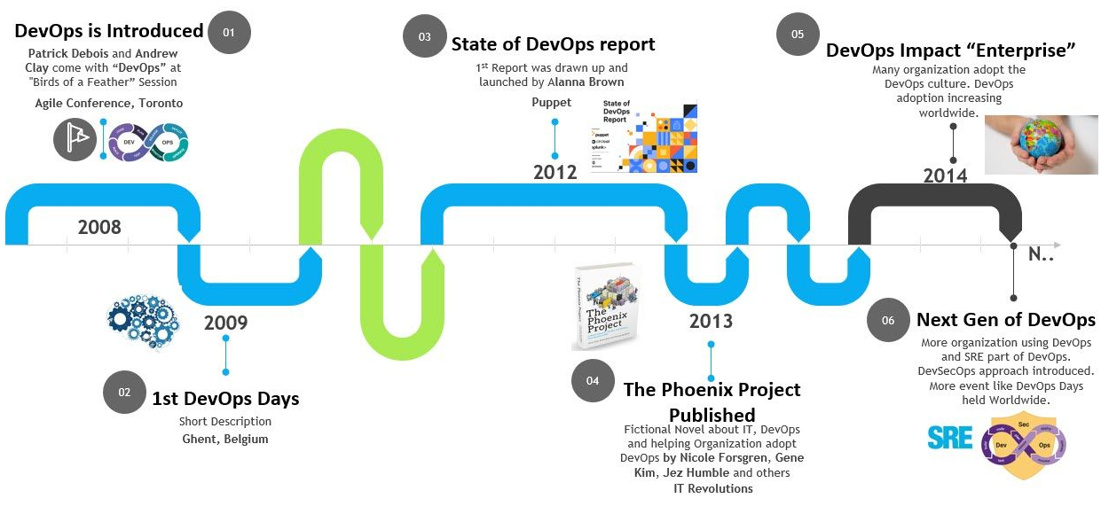
History

Slide 4
Configuration management
Process of maintaining systems, such as computer hardware and software, in a desired state
Configuration Management (CM) is also a method of ensuring that systems perform in a manner consistent with expectations over time.

Slide 5
Benefits of Configuration Management
Reduces risk of unpredictable system failures
because it offers perfect visibility and tracks every change made to test environments.
Reduces costs
Offers greater agility and better resolution of issues
Implement faster restoration of services

Slide 6
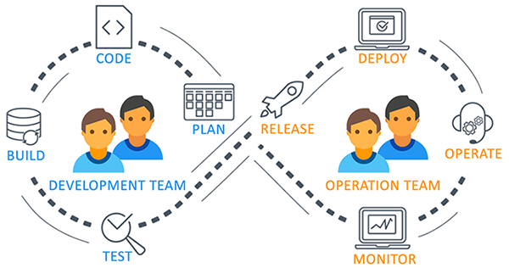
What and why of DevOps?

Slide 7

What and why of DevOps?

Slide 8
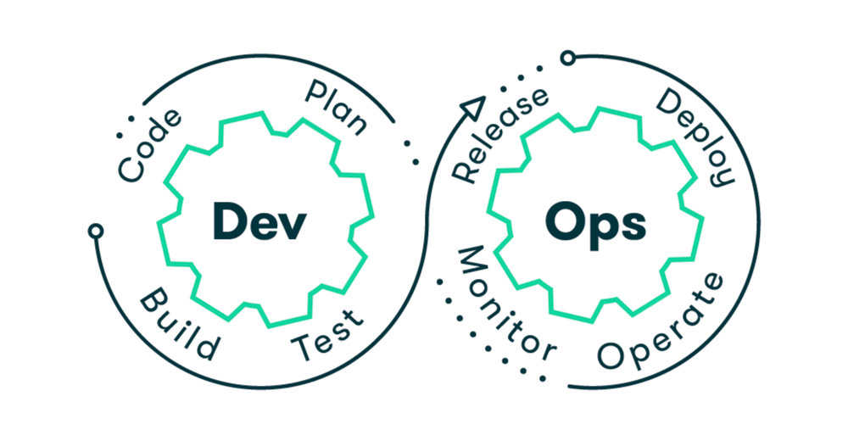
What and why of DevOps?

Slide 9
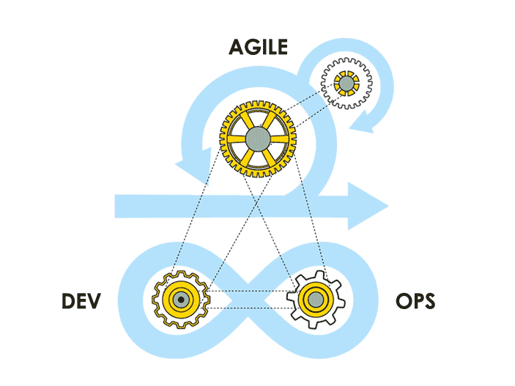
What and why of DevOps?

Slide 10

What and why of DevOps?

Slide 11
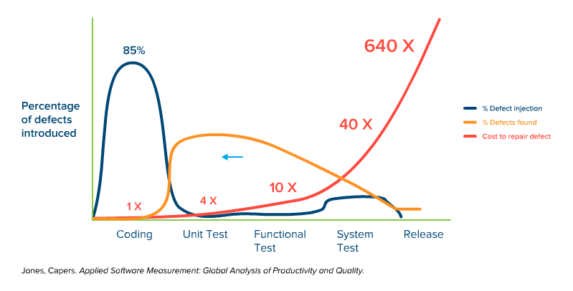
Early Defects vs Delayed Defects detection

Slide 12

DevOps as a solution and Advantages

Slide 13
DevOps Tools – Overview and Use case

Slide 14
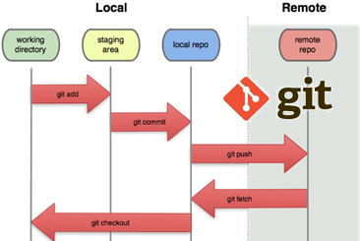
Source control
To ensures for working on the right version
Important for maintaining a single source of truth

Slide 15
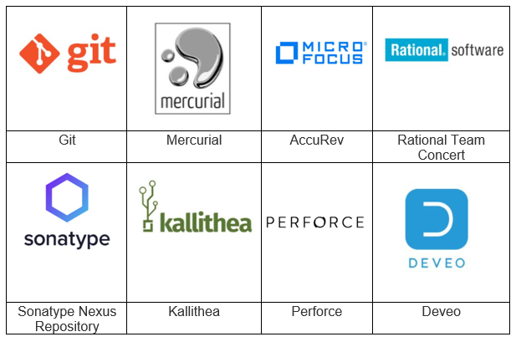
Source Code Management (SCM Tools)
Help to keep track of code
Complete history of changes.

Slide 16
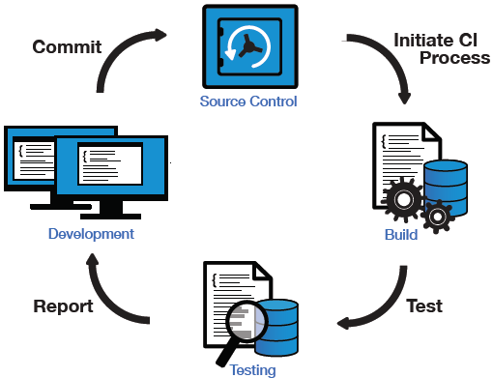
Continuous Integration
Push

Slide 17
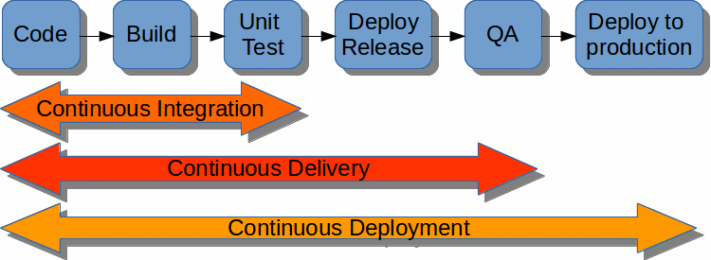
Continuous Delivery and Deployment

Slide 18
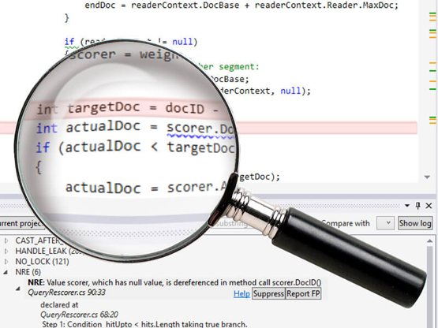
What Is Static Code Analysis?
A method of debugging
Examine source code before a program is run
Done by analyzing a set of code against a set of coding rules.
Performed early in development

Slide 19
Static Code Analysis Tool
Development teams are under pressure
Quality releases needed to be delivered on time
Coding and compliance standards need to be met
And mistakes are not an option.
That’s why development teams are using static analysis tools.

Slide 20
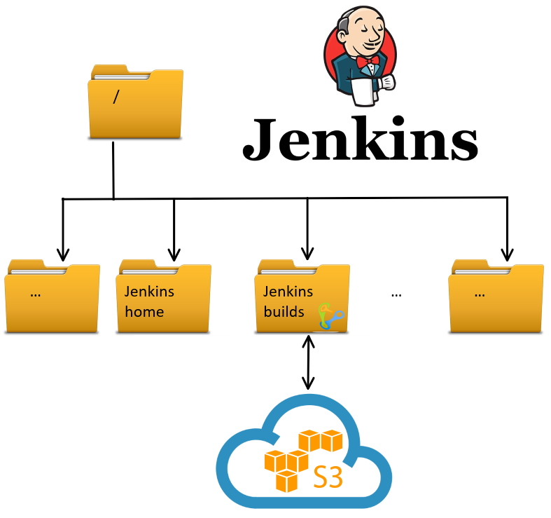
Storage Artifacts

Slide 21
Configuration Management
A process for maintaining
Computer systems
Servers, and
Software in a desired, consistent state
Notes:
Why manage configurations?
Keeps you from making small or large changes that go undocumented
These misconfigurations can lead to poor performance, inconsistencies, or noncompliance and negatively impact business operations and security.
When undocumented changes are made across many systems and applications, it adds to instability and downtime.

Slide 22
Benefits of Configuration Management for Servers
Quick Provisioning of New Servers
Quick Recovery from Critical Events
Version Control for the Server Environment
Replicated Environments

Slide 23
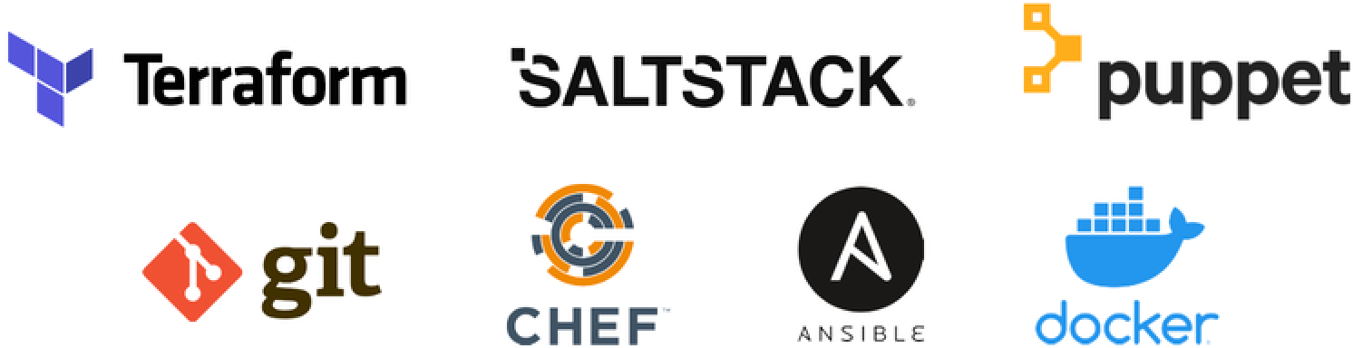
Configuration Management Tools

Slide 24
Thanks

